Slide 1

Rent a car

Slide 2
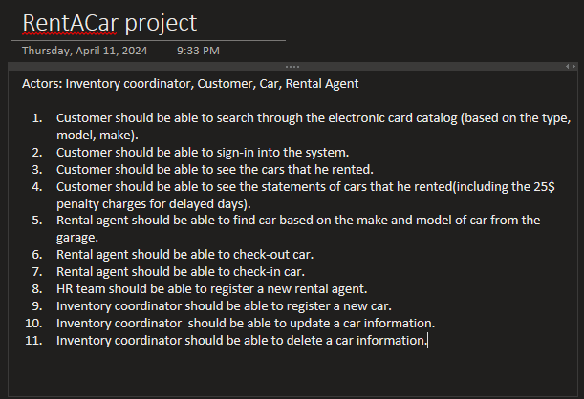
Software Requirements

Slide 3
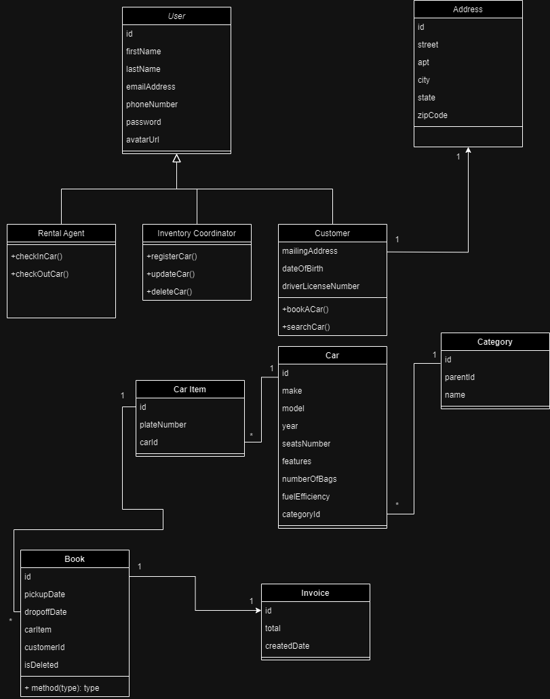
Class Diagram

Slide 4
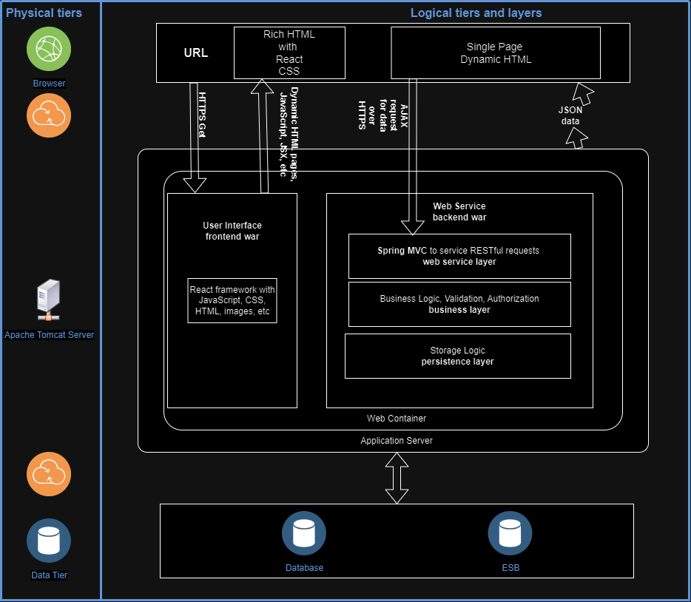
Software Solution Architecture Diagram

Slide 5
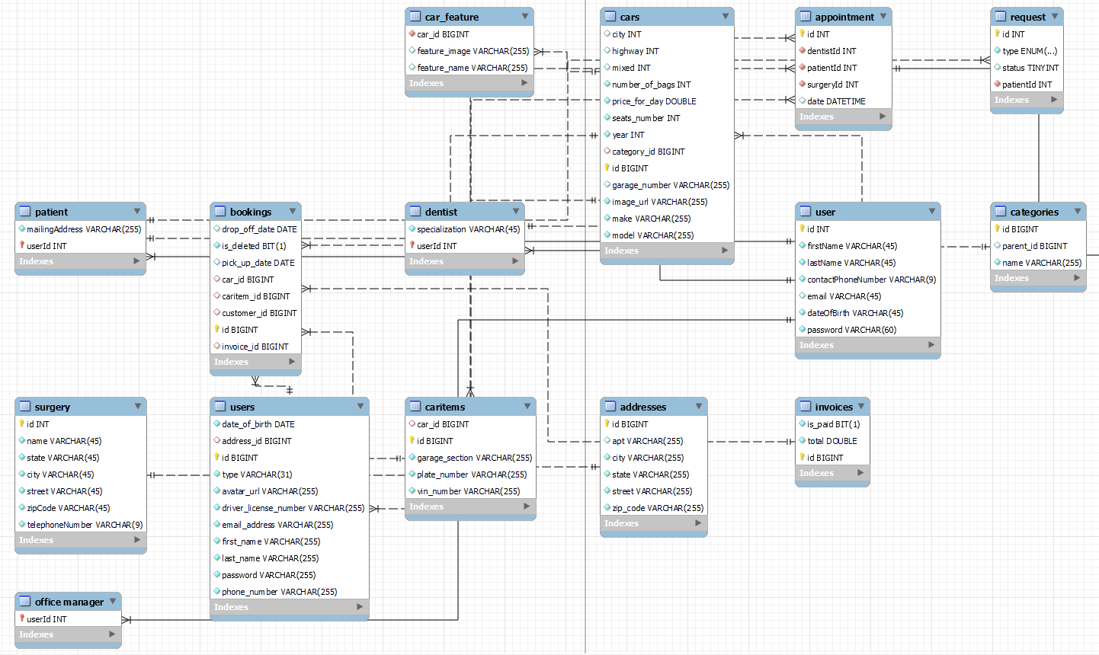
ER diagram

